Slide 1
Week 13-Lec 1 Switched Ethernet

Slide 2

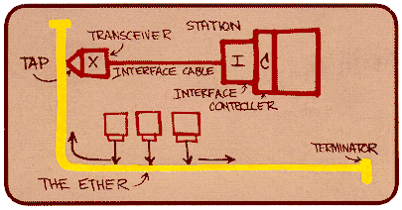
Ethernet
“dominant” wired LAN technology:
first widely used LAN technology
simpler, cheaper than token LANs and ATM
kept up with speed race: 10 Mbps – 10 Gbps
Metcalfe’s Ethernet sketch
Link Layer
5-2
Notes:
2

Slide 3
Ethernet frame structure
sending adapter encapsulates IP datagram (or other network layer protocol packet) in Ethernet frame
preamble:
7 bytes with pattern 10101010 followed by one byte with pattern 10101011
used to synchronize receiver, sender
addresses:
6 byte source, destination MAC addresses
type: indicates higher layer protocol – IPv4 or v6
CRC: cyclic redundancy check at receiver
error detected: frame is dropped
type
preamble
dest.
address
source
address
data (payload)
CRC

Slide 4
802.3 Ethernet standards: link & physical layers
many different Ethernet standards
common MAC protocol and frame format
different speeds: 2 Mbps, 10 Mbps, 100 Mbps, 1Gbps, 10G bps
different physical layer media: fiber, cable
application
transport
network
link
physical
MAC protocol
and frame format
100BASE-TX
100BASE-T2
100BASE-FX
100BASE-T4
100BASE-SX
100BASE-BX
copper (twister
pair) physical layer
fiber physical layer
Link Layer
5-4
Notes:
4

Slide 5
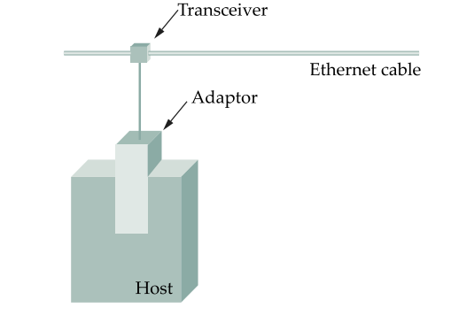
Ethernet Segments
Ethernet segment cable size 500 m
Hosts connect to segment by tapping which has a transceiver (Tx, Rx)
Network adapter in the device (NIC) connects to the transceiver
Mulitple NICs can be connect across the 500 m cable with tap points being 2.5 apart (Standards)
Ethernet protocol implemented in the NIC
Multiple segments joined through repeaters
Max 4 segments = 2000m
Max 1024 hosts
Repeaters:
forward digital signals
Multiport repeater is a Hub

Slide 6
Classic Ethernet
Stations on single shared bus
Collisions if no proper protocol
Ethernet –CSMA
Carrier Sense Multiple Access –CD
Exponential back-off
Collisions reduced

Slide 7
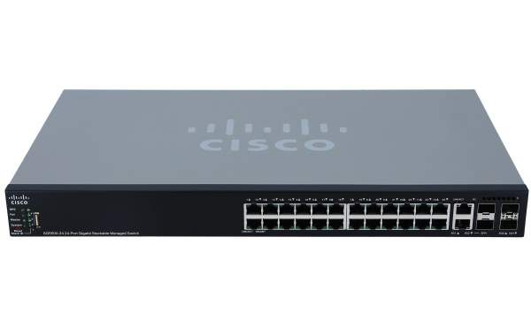
Architectural change
Switched ethernet

Slide 8
Ethernet switch
link-layer device: takes an active role
store, forward Ethernet frames
examine incoming frame’s MAC address, selectively forward frame to one-or-more outgoing links when frame is to be forwarded on segment, uses CSMA/CD to access segment
transparent
hosts are unaware of presence of switches
plug-and-play, self-learning
switches do not need to be configured

Slide 9



Switch: multiple simultaneous transmissions
hosts have dedicated, direct connection to switch
switches buffer packets
Ethernet protocol used on each incoming link, but no collisions; full duplex
each link is its own collision domain
switching: A-to-A’ and B-to-B’ can transmit simultaneously, without collisions
A
C’
B
6
1
2
5
4
3
B’
C
A’
switch with six interfaces
(1,2,3,4,5,6)

Slide 10
Switch: frame filtering/forwarding
when frame received at switch:
1. record incoming link, MAC address of sending host
2. index switch table using MAC destination address
3. if entry found for destination then {
if destination on segment from which frame arrived then drop frame –BROADCASTED ALREADY
else forward frame on interface indicated by entry
}
else flood /* forward on all interfaces except arriving
interface */
But how des the switch get this forwarding interface information? i.e,
how does it know which device is conenected to which interface?

Slide 11
Switch forwarding table
Q: how does switch know A’ reachable via interface 4, B’ reachable via interface 5?
A
C’
B
A: each switch has a switch table, each entry:
(MAC address of host, interface to reach host, time stamp)
looks like a routing table!
6
1
2
5
4
3
B’
C
A’
Q: how are entries created, maintained in switch table?
something like a routing protocol?
switch with six interfaces
(1,2,3,4,5,6)

Slide 12
Switch: self-learning
Source: A
Dest: A’
switch learns which hosts can be reached through which interfaces
when frame received, switch “learns” location of sender: incoming LAN segment
records sender/location pair in switch table
A
A A’
C’
B
6
1
2
5
4
3
B’
C
A’
MAC addr interface TTL
A
1
60
Switch table
(initially empty)

Slide 13
Self-learning, forwarding: example
Source: A
Dest: A’
A
A A’
frame destination, A’, locaton unknown:
flood
C’
B
destination A location known:
6
1
2
A A’
A A’
A A’
A A’
selectively send
on just one link
A A’
5
4
3
B’
C
A’ A
A’
MAC addr interface TTL
A
1
60
switch table
(initially empty)
A’
4
60

Slide 14

Interconnecting switches
switches can be connected together
S₄
S₁
S₃
A
S₂
F
I
B
C
D
E
G
H
Q: sending from A to G - how does S₁ know to forward frame destined to F via S₄ and S₃?
A: self learning! (works exactly the same as in single-switch case!)

Slide 15
Self-learning multi-switch example
Suppose C sends frame to I, I responds to C
S₄
S₁
S₃
A
S₂
F
I
B
C
D
E
G
H
Q: show switch tables and packet forwarding in S₁, S₂, S₃, S₄

